Slide 1
Good to be me
To recognise that each of you is special.

Slide 2
Being special
This assembly is about you, every single one of you, because each of you are special.
What do you think the word special means?

Slide 3
Special
Excellent in some way
Different from others
Unique
In a class of there own

Slide 4
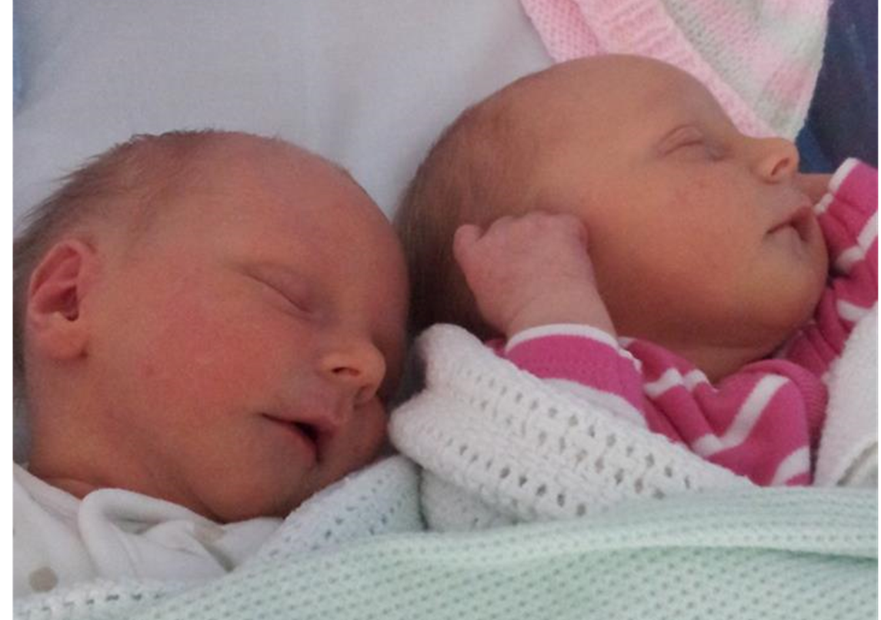

Slide 5
Every time a baby is born, that baby is special, never in the history of the world has a baby quite like that one been born before.
Each one of you is absolutely special.
Even though there are millions and millions of children all across the world, no two of them are the same. Each of them has something special that makes them who they are.

Slide 6
Talking Partners
Turn to your partner and say some of the ways in which you are different from others.

Slide 7
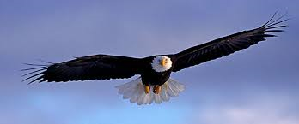
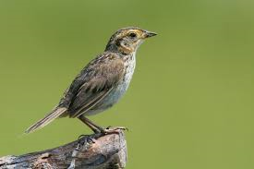
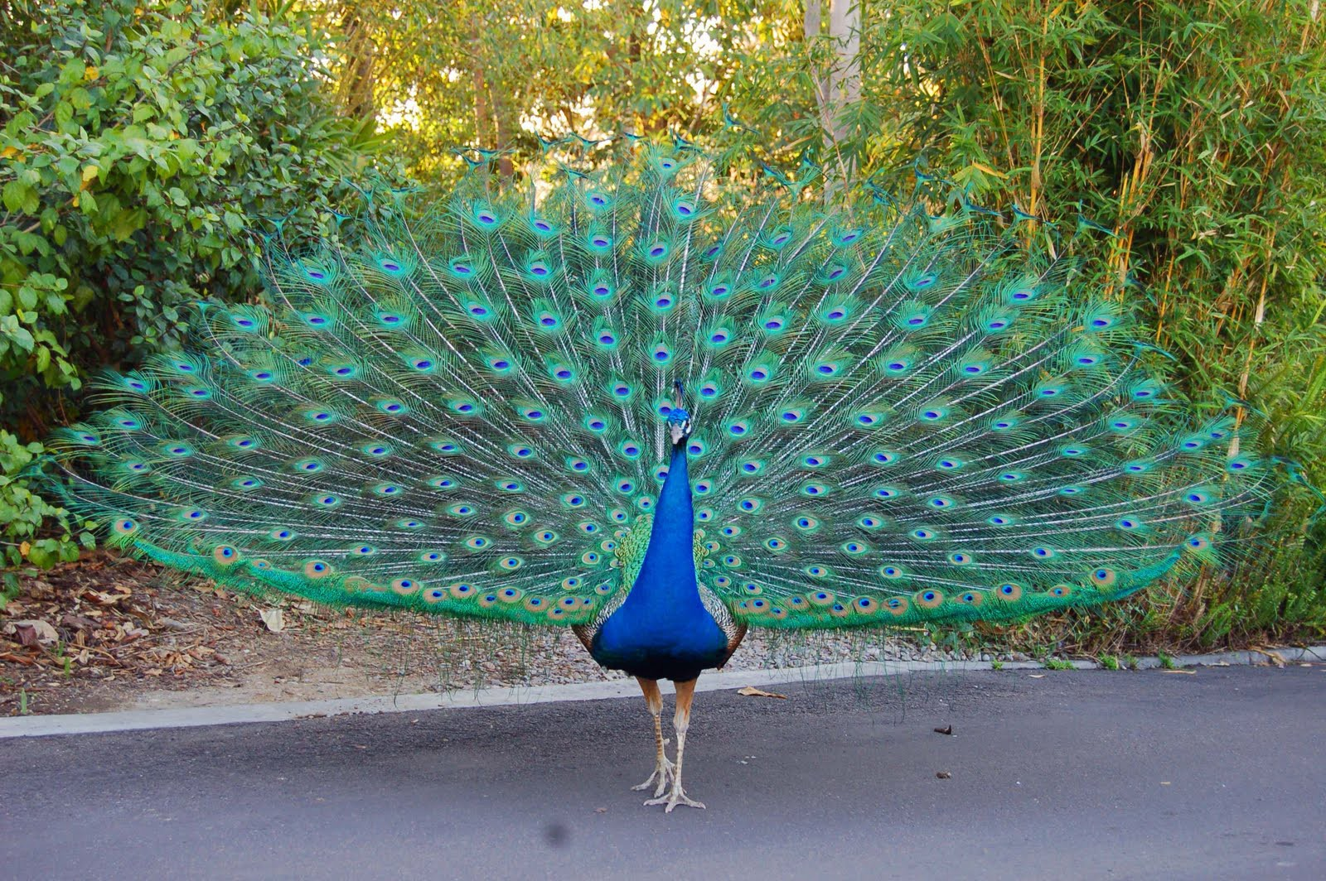
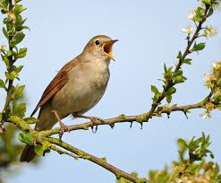
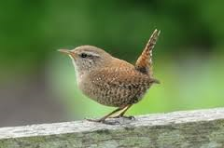
The Sparrow

Slide 8
Quiet time
Every child has a different way of being special.
It isn’t only about what they look like, or what they are good at, each child is unique and special in his or her own
particular way.
Sometimes it is hard to remember how special each of us is. Sometimes we think that others can do things so much better than we can.
Sometimes, when we feel bad, we forget what our special gifts are.

