Slide 1
Giles Nursery and Infants’ School
New School Council Members.

Slide 2
With my own eyes, I see the world.
The lovely world of God.
My heart give thanks that I may live in this, God’s world.
That I may wake in the brightness of day
And rest at night in the blessing of God.

Slide 3
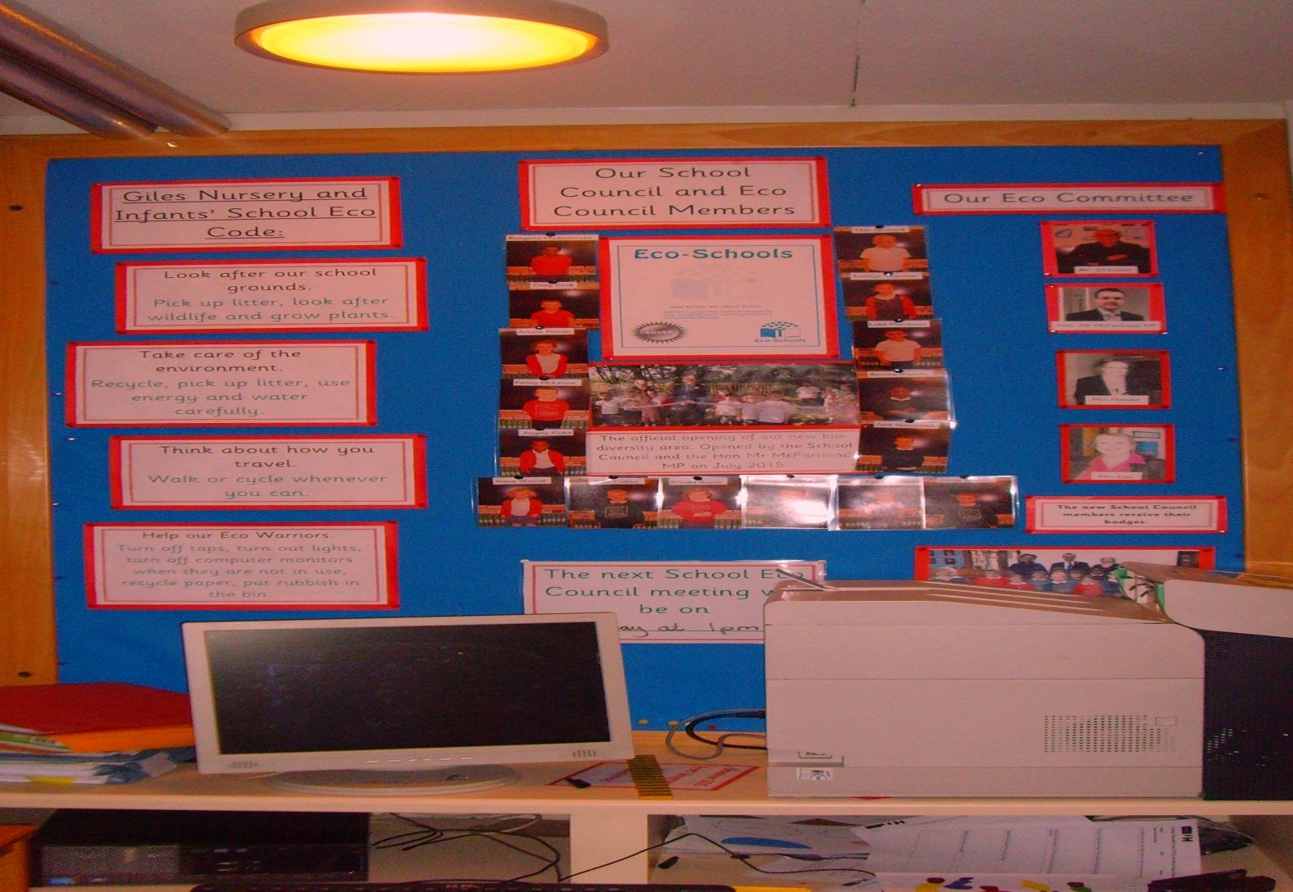
School Council Board

Slide 4
We had a challenge last year. We needed to rebuild the eco - area.
The school council raised money and chose new equipment. It was opened in the summer.

Slide 5

Over the years the school council has made Giles Infants’ even better by making all pupils more aware of healthy living.
Mrs Clark also worked really hard and helped the school earn Healthy Schools Status.

Slide 6
This year the children will complete the environmental review and then choose a new topic to help improve our school.

Slide 7
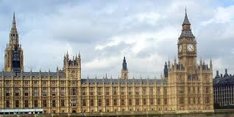
Can you name this building?

Slide 8
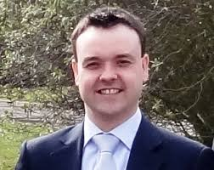
Hon Stephen McPartland MP
Eco Committee
member

Slide 9
Our New School Council Members
Year 2 | Year 1 | Reception
Max | Bettina | Brooke
Katelyn | Finlay | Jacob
Rungano | Jack | Jack
Cody | Angela | Amelia
 | Amelie | Alexa
 | Luke | Harrison

Slide 10
Turn Back The Clocks
Turn back the clocks now that Harvest is over and done.
Look for the signs all around that the Autumn has come.

Slide 11
The days are getting shorter,
The nights are drawing in.
The air’s getting much colder,
Now Autumn time has come again.

Slide 12
Look at the beautiful colours that blaze from the trees
Orangy-red, green and yellows, so lovely to see.
The days are getting shorter,
The nights are drawing in.
The air’s getting much colder,
Now Autumn time has come again.

Slide 13
Sweep up the leaves that are falling all over the ground.
See all the squirrels go storing up nuts they have found.
The days are getting shorter,
The nights are drawing in.
The air’s getting much colder,
Now Autumn time has come again.

Slide 14
Soon there’ll be grey misty mornings and fresh chilly air.
We’ll wrap up warmly, but most of the trees will be bare.
The days are getting shorter,
The nights are drawing in.
The air’s getting much colder,
Now Autumn time has come again.

