Slide 1
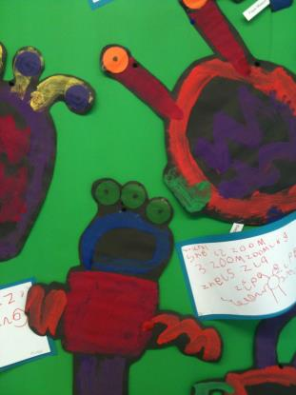
Foundation Stage 2015
The Early Years Foundation Stage

Slide 2
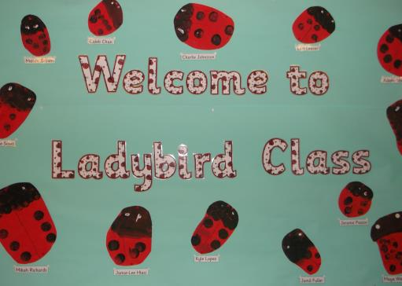
Nursery Classes
Ladybirds

Slide 3
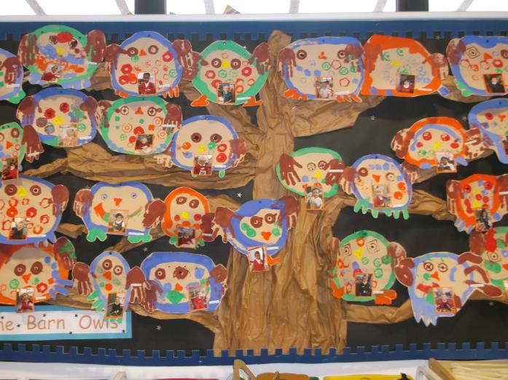
Reception Classes
Barn Owls Tawny Owls Snowy Owls

Slide 4
Prime Areas Of Learning
Language for Communication and Thinking.
Listening skills / Speaking / Understanding
Personal, Social and Emotional development.
Self care / Behaviour /Empathy for others
Physical development.
Fine motor and Gross motor development.
The prime areas begin to develop quickly in response to relationships and experiences, and run through and support learning in all other areas. The prime areas continue to be fundamental throughout the EYFS.

Slide 5
Specific Areas of Learning
Literacy:Reading and Writing development
Maths: Number / Shapes, Space and Measures.
Understanding of the World:
Exploration & Investigation / Place / Time /RE.
Expressive Arts and Design: Art, DT, Music and Imaginative play.
The specific areas include essential skills and knowledge.
They grow out of the prime areas, and provide important contexts for learning.
The prime and specific Areas of Learning and Development are all interconnected.

Slide 6
The Early Years Outcomes
This guidance helps us to support children’s learning and development, by closely matching what we provide to a child’s current needs.
They are used throughout the year to track pupil progress and to guide our planning.
On Going Assessment : Ages & Stages (Age-Related Expectations)
The Early Years Outcomes are used by early years settings throughout the EYFS as a guide to making best-fit judgements about whether a child is showing typical development for their age, or may be at risk of delay or is ahead for their age.
On-going formative assessment is at the heart of effective early years practice.
We observe children as they act and interact in their play, in everyday activities and planned activities. Then consider ways to support the child to strengthen and deepen their current learning and development.
Where appropriate, we use the development statements to identify possible areas in which to challenge and extend the child’s current learning and development (planning).
This way of teaching is particularly appropriate to support learning in early years settings.

Slide 7
Summative Assessment The EYFS requires early years practitioners to review children’s progress and share a summary with parents at two points:
• in the prime areas between the ages of 24 and 36 months
• and at the end of the EYFS in the EYFS Profile.
Summative assessment supports information sharing with parents, colleagues and other settings. Analysing observations and deciding what they tell us about children.
New Reception Baseline Assessments.
A National requirement for 2015 for children starting in the Reception year.
Although each local authority has been able to adopt the assessment scheme they preferred.
These are not formal tests but an assessment made through observations and interactions during play-based activities.

Slide 8
The Planning and Learning Cycle.

Slide 9
The Characteristics of Effective Learning.
The ways in which the child engages with other people and their environment – playing and exploring, active learning, and creating and thinking critically – underpin learning and development across all areas and support the child to remain an effective and motivated learner.

Slide 11
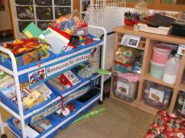
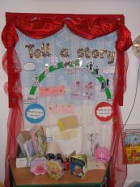
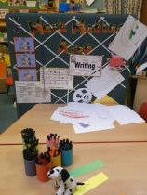
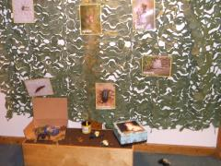
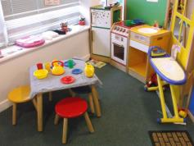
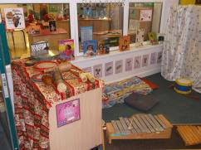
Time for some pictures of what a good learning provision looks like: The Nursery.
Resources are accessible and appealing for the children and they are able to make their own choices.

Slide 12
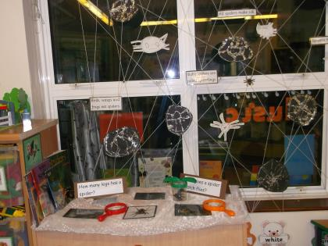
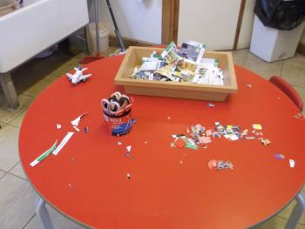
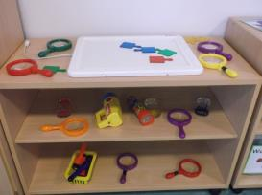
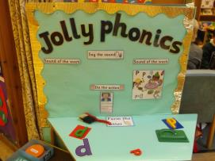
Encouraging investigation and sustained thinking.

Slide 13
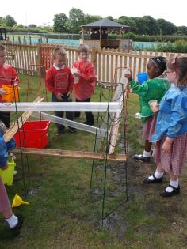
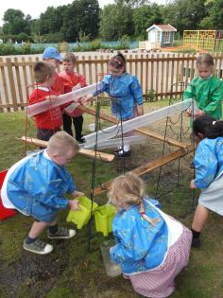
Learning outdoors
Total engagement, sustained thinking and trying out their own ideas.
Working together, persevering and learning from mistakes!

Slide 14
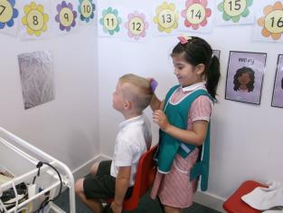
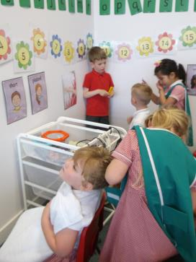
Role-play The Salon. Having fun! Learning at its best.

Slide 15
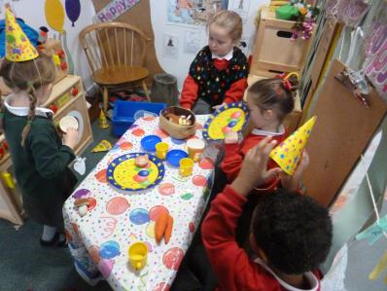
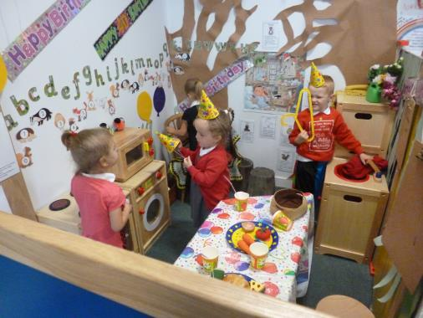
Role Play! Fox’s birthday party in Percy’s hut…

Slide 16
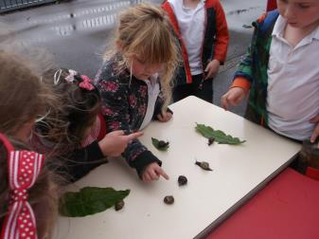
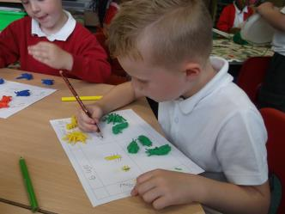
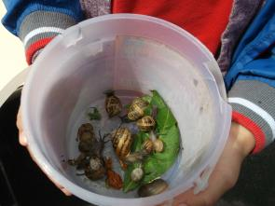
Teaching new skills and knowledge

Slide 17
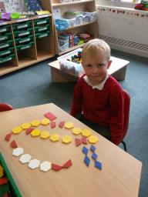
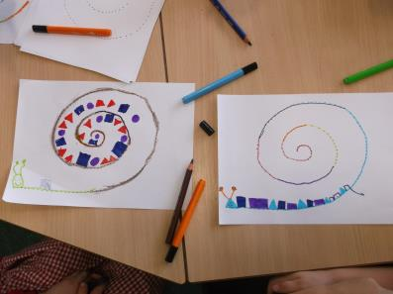
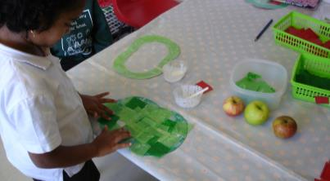
Creativity

Slide 18
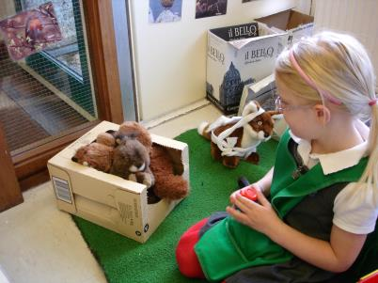
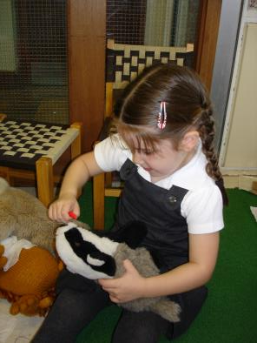
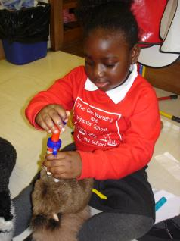
Taking care of the animals in the wildlife sanctuary.

Slide 19
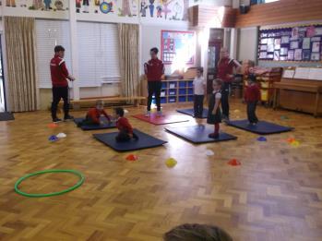
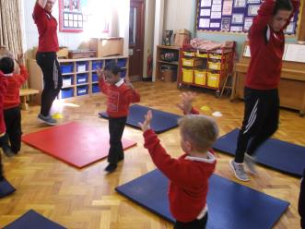
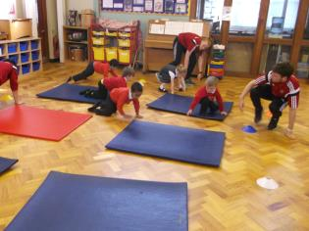
Sports Apprentice Scheme

Slide 20
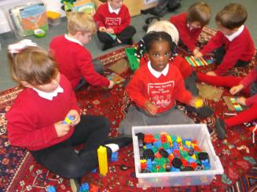
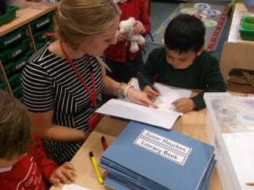
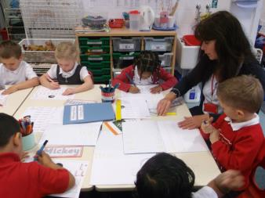
A balance of learning to become independent learners and direct teaching.

Slide 21
Providing additional support for children with English as an additional language or children who require additional learning support with highly skilled staff.
Support is a mix of 1:1 within the classroom or a small group activity in a quiet area
or a small group in the hall or outside.

Slide 22
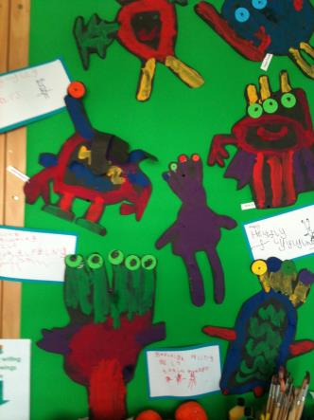
I hope this brief glimpse into the Foundation Stage has shown just how much fun… and of course learning is going on in the Foundation Stage!

